Slide 1
Understanding Frequency Ratios between Musical Intervals
Hiroshi Wang
Aerospace Engineering at the Georgia Institute of Technology
November 21, 2023

Slide 2
Introduction
Background:
Digital Data Acquisition Systems (DAQ) allow for real-world physical conditions to be taken as digital data
Sampling rate and record length affect how the data is taken and thus must be adjusted
Noise can be filtered using low or high-pass filters
In addition to different amplitudes and frequencies, waves can come in different forms
Guitar strings produce sound waves which can be recorded with a microphone
Intervals are set differences in pitch between two notes, which can be compounded to create a chord.

Slide 3
Introduction
Objectives and Motivation:
Categorize different types of waves and their behavior
Explore sampling rate, record length, noise and filtering
Characterize the DAQ-Microphone system
Test relative responses from directly vs microphone recorded data
Calculate error in measurements by comparing to standardized data
Measure and calculate ratio of peak frequencies between intervals
Answer: How does frequency ratio relate to consonance and dissonance?
Analyze overtones and their presence in the waveform

Slide 4

Approach
Instruments Used:
LabJack T4 DAQ
GTAE Simple DAQ
Microphone and 3.5 mm audio breakout adapter
Adobe Audition Digital Audio Workstation
Yamaha Pacifica and Yamaha THR10II Amplifier/Interface
Experiment Setup:
Experiments were performed in my room, which had minimal external noise
Microphone was connected to DAQ which then the Simple DAQ application was used to interpret/record the microphone data
Audio breakout adapter was connected to the DAQ, which allowed for the direct measurement of sounds coming from the device

Slide 5
Approach
Experimental Procedure:
For Lab Manual:
Determine shape of the given waveforms, analyze power spectra and their behavior
Test the effects of sampling rate and record length
Examine quantization error, aliasing, and identify types of noise present
Record 10 frequencies with the microphone and compare with direct data. Calculate relative response
For Experiment:
Connect microphone to DAQ and keep it 5 centimeters away from the amplifier
Play several notes on guitar, observing results on GTAE Simple DAQ
Set sample rate and record length. Apply filters as needed
Play root note as well as 5 other intervals. Record results on Simple DAQ
Plot and analyze the data, making note of peaks. Calculate frequency ratio
Translate peak frequencies to notes and determine the behavior of overtones
Compare data to standardized note values and record error
Notes:
Distance between mic and amplifier was kept constant, as well as the amplifier volume

Slide 6
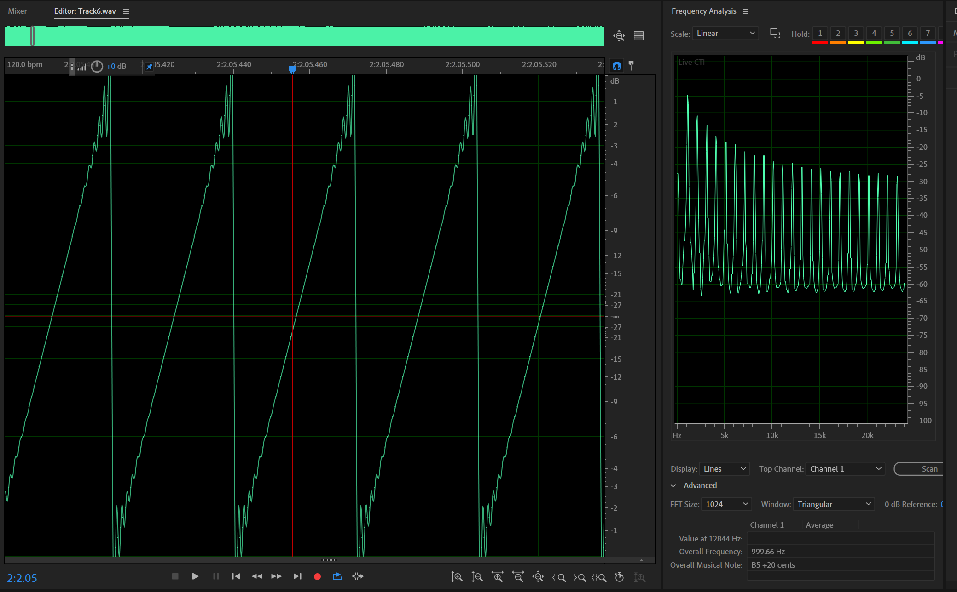
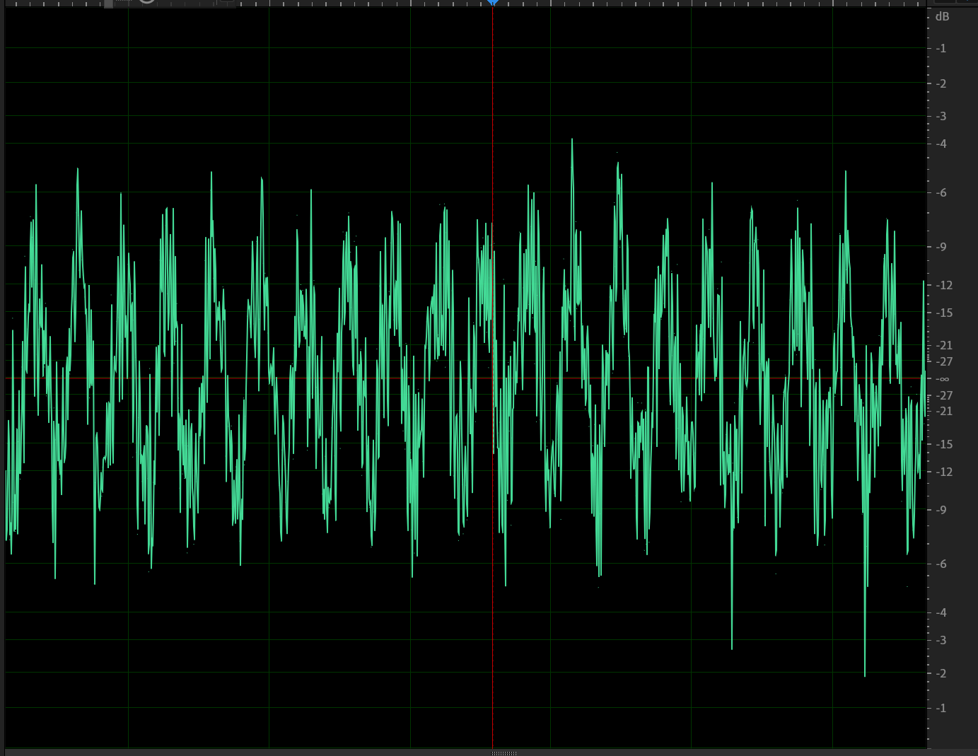
Results from Lab Manual
Track Number | Type of Signal | Peak Frequencies Observed
1 | Single Sine wave | 100 Hz
2 | Single Sine wave | 1000 Hz
3 | Triangle wave | 1000, 3000, 5000, 7000 Hz
4 | Square wave, some noise | 1000, 3000, 5000, 7000 Hz
5 | Single Sine wave | 3000 Hz
6 | Ramps | 1000, 2000, 3000, 4000, 5000, 6000, 7000 Hz
7 | Single Sine wave, some noise | 1000 Hz
8 | Single Sine wave, more noise | 1000 Hz
9 | Sum of Three Sine Waves | 100, 1000, 10000 Hz
10 | Product of Two Sine Waves (Amplitude Modulation) | 900, 1100 Hz
11 | Sine of a Sine (Frequency Modulation) | Varies from 0-1000 Hz
Notes:
Distance between mic and amplifier was kept constant, as well as the amplifier volume

Slide 7
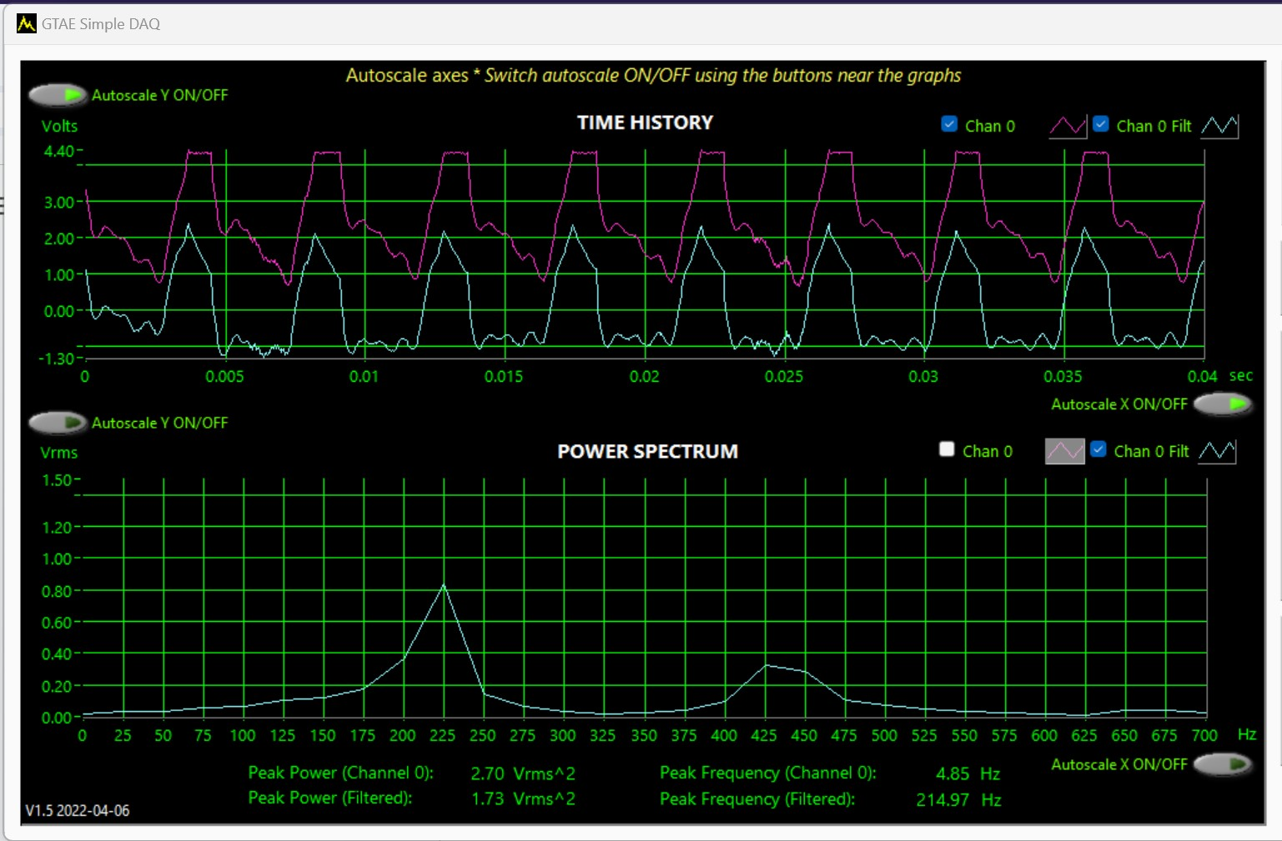
Results from Lab Manual
Aliasing
Sample Rate | Peak Frequencies | Aliasing Present?
5000 S/s | 0, 100, 1000 Hz | Yes
7500 S/s | 100, 1000, 2500 Hz | Yes
25000 S/s | 100, 1000, 10000 Hz | No
Low-Pass Filter
Cutoff Frequency | Effects of the Filter
5000 Hz | Cutoff frequency was slowly lowered until the highest frequency was unnoticeable. A 5kHz low-pass filter was needed to eliminate a 10kHz sine wave. It has a slight impact on two other lower frequencies.
Notes:
As I increase the sample rate, the frequencies of the 3 peaks changed. The highest one changed until I was able to map 10,000 Hz, which was at 20,000 S/s. The image here shows a high pass filter cutting out low frequeuncies.

Slide 8
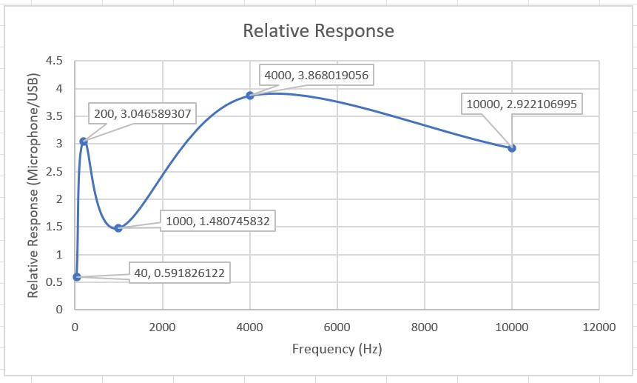
Relative Responses
The responsiveness of the microphone was compared the directly measured using aux cable
Five frequencies were measured
The lower relative response at 1kHz meant the microphone responded weakly to this range of frequencies
Directly Measured Power | Microphone-Recorded Power | Response Ratio
0.255766 | 0.151369 | 0.591826122
0.30507 | 0.929423 | 3.046589307
0.30409 | 0.45028 | 1.480745832
0.304991 | 1.179711 | 3.868019056
0.300181 | 0.877161 | 2.922106995
Notes:
As I increase the sample rate, the frequencies of the 3 peaks changed. The highest one changed until I was able to map 10,000 Hz, which was at 20,000 S/s. The image here shows a high pass filter cutting out low frequeuncies.

Slide 9
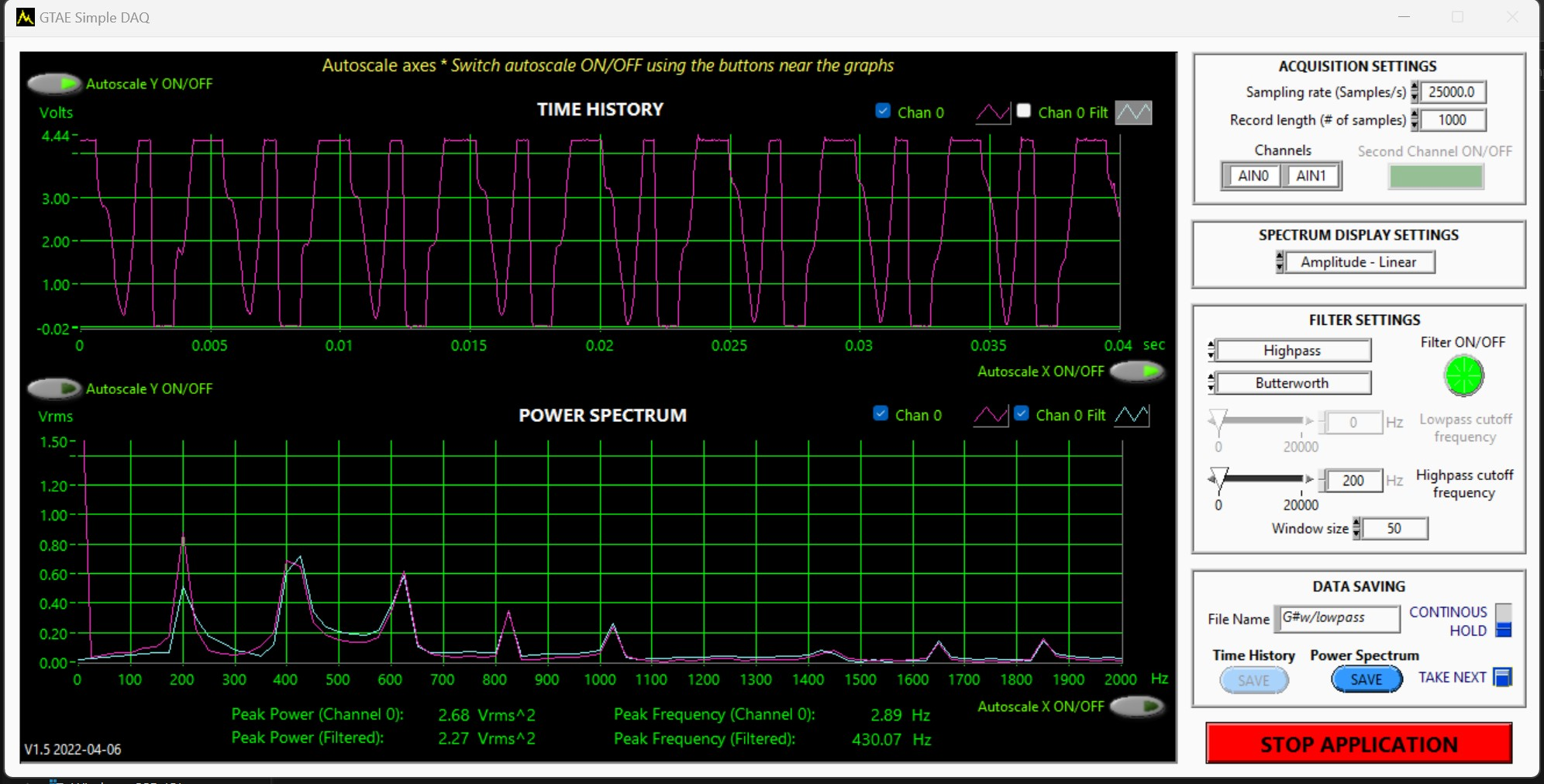
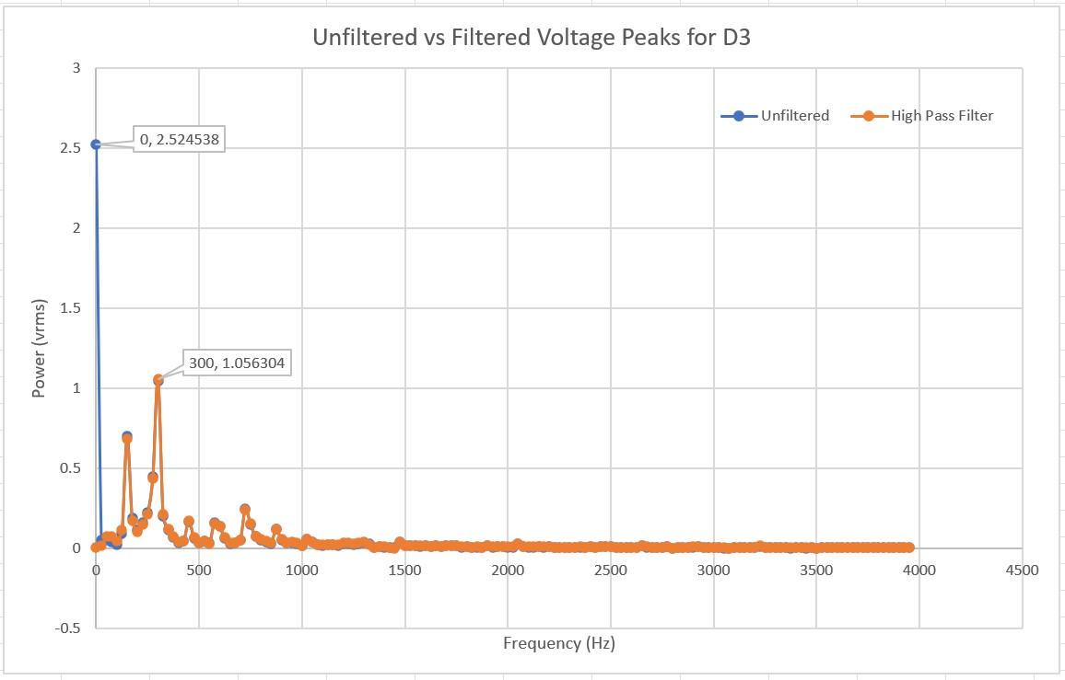
Raw Data and Data Reduction
A high-pass filter was used to cut off the peak near 0 Hz
The guitar’s lowest possible note was used to figure out the cutoff frequency
Possibly pink noise
Title
Data from GTAE Simple DAQ was stored in a text file, and Excel was used to plot the data
As for axis scaling, while there were peaks at higher frequencies, the highest note on guitar was used as a limit.

Slide 10
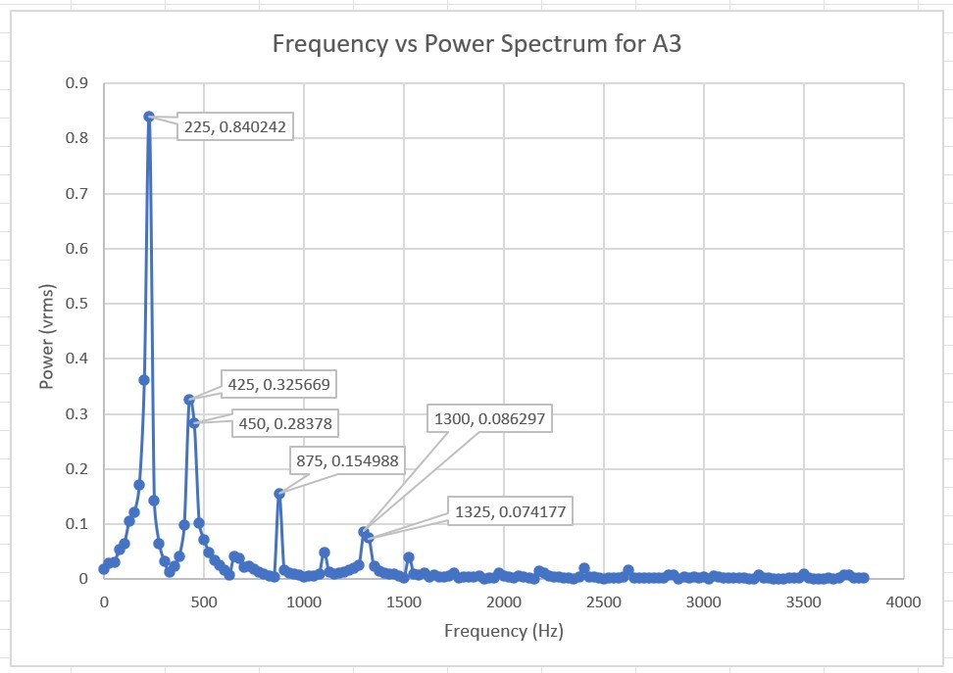
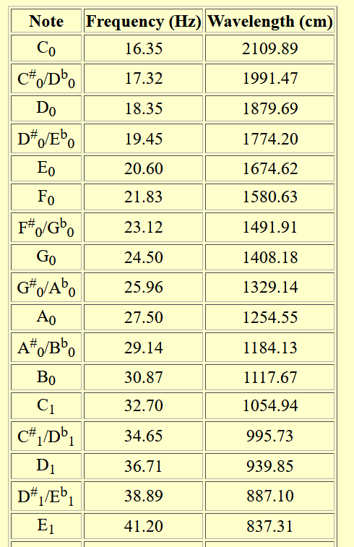
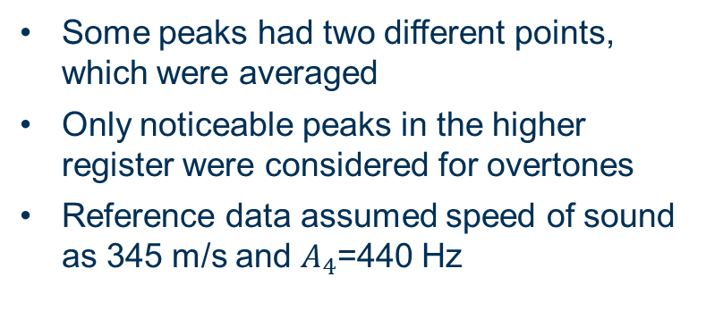
Raw Data and Data Reduction
Some peaks had two different points, which were averaged
Only noticeable peaks in the higher register were considered for overtones
Reference data assumed speed of sound as 345 m/s and $A_{4}$=440 Hz
Title
Notes:
12 tone equal temperament – 12 notes, there are other tunings like just intonation or a=432

Slide 11
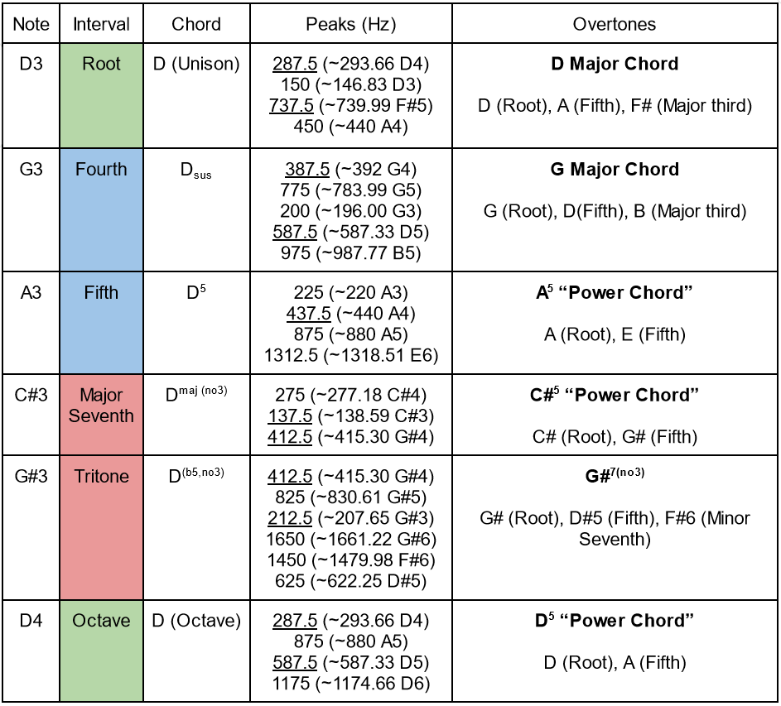
Results from Experiment
Overtones spell out major triads
Root notes and its octaves
Fifth
Major third
More noticeable in lower frequency notes
Due to the relative response as well as overtones, some of the lower notes rung out more than the fundamental
With no effects, there is no compression, meaning the notes near the mid-range ring out more on guitar.
Resonance frequency can cause other strings to vibrate
Notes:
Each instrument has different overtones, which add to their timbre. It's how you can tell the difference between a guitar, a trombone, a piano, a piccolo and a drum all playing the same pitch.

Slide 12
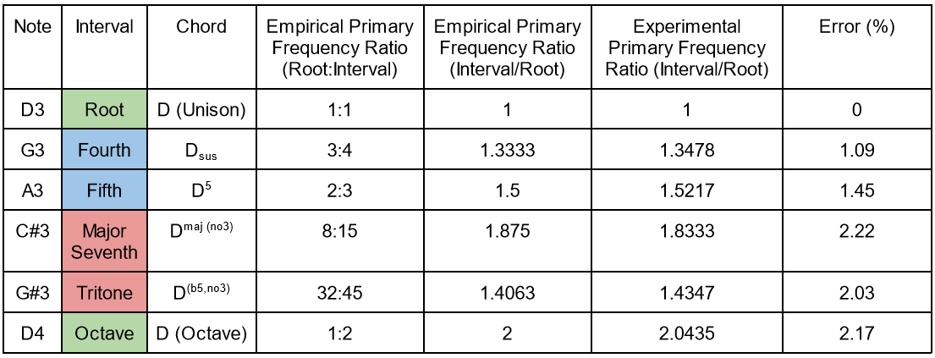
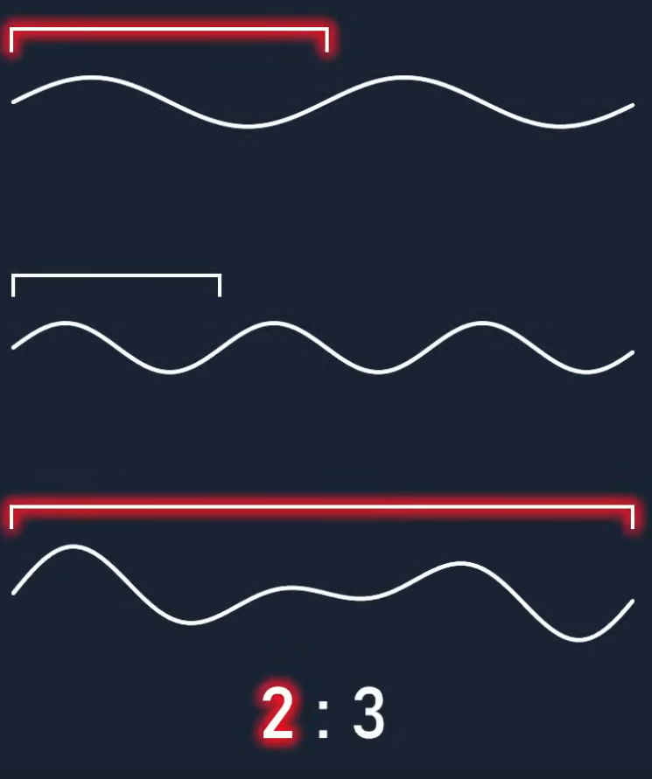
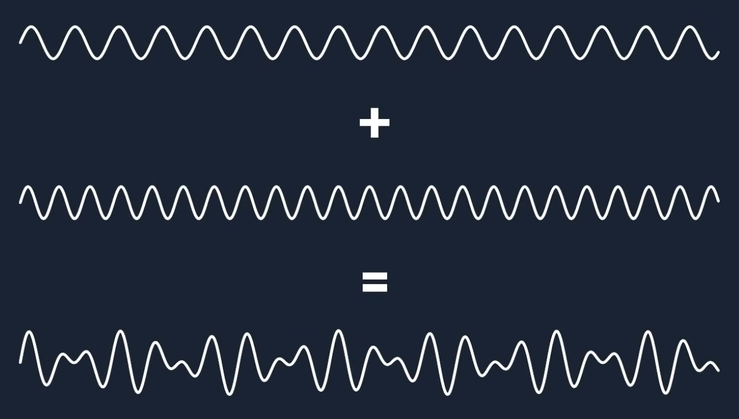
Results from Experiment
From most consonant to most dissonant:
Octave (2:1)
Fifth (3:2) and Fourth (4:3)
Major Third (5:4) and Minor Sixth (8:5)
Minor Third (6:5) and Major Sixth (5:3)
Major Second (9:8) and Minor Seventh (16:9)
Minor Second (16:15) and Major Seventh (15:8)
Tritone (45:32 or 25:18)
Title
Consonant intervals have simple whole number ratios
Sound like they “agree”, simple pattern
Dissonant intervals have complex ratios
Sound like they “disagree”, irregular pattern
Relative relationships between intervals have relatively low error
Error increases as interval becomes farther
Notes:
Ex. For perfect fifth, the resulting wave period is 2 times the root and 3 times the higher note. (our brains can recognize this pattern easily) Thus how consonant or dissonant an interval is is relative and can be ranked, as shown here, www.harmony.org.uk. this is the empirical data in which is the most consonant and dissonant, which our experiment confirms.

Slide 13
Conclusion
Success criteria:
Characterized the microphone-DAQ system and how they measured data
Relative responses
Filtering, sampling rate, record length
Was able to verify the frequency ratios between intervals and understand how they related to their function in music
Consonance correlated with simple ratios and dissonance complex
Overtones manifest themselves as major chords
Title
Complications and Error Mitigation
Effects completely changed the waveform
Some overtones were picked up more than the fundamental frequency
GTAE Simple DAQ did not show the frequencies in the best resolution; Audition was used to confirm results
A dynamic mic with a frequency response more suited for guitar note ranges
Better sound insulation or a studio to record guitar
Testing all eight intervals and different guitars
Notes:
Effects completely change the waveform, such as distortion compressing the signal. Would be a great to explore as a further experiment. All eight intervals as well as using different strings could be done to ensure the results were correct regardless of guitar setup.

Slide 14
References
Gonkee. (2021, March 13). The math behind music and Sound synthesis. YouTube. https://www.youtube.com/w atch?v=Y7TesKMSE74&list=LL&index=7
Sutcliffe, T. (n.d.). Consonance and Dissonance. Consonance and dissonance. https://www.harmony.org.uk/boo k/voice_leading/consonance_and_dissonance.htm
Tuning. Frequencies of Musical Notes, A4 = 440 Hz. (n.d.). https://pages.mtu.edu/~suits/notefreqs.html
Müller, M. (n.d.). Intervals. AudioLabs. https://www.audiolabserlangen.de/resources/MIR/FMP/C5/C5S1_Interval s.html

